Slide 1
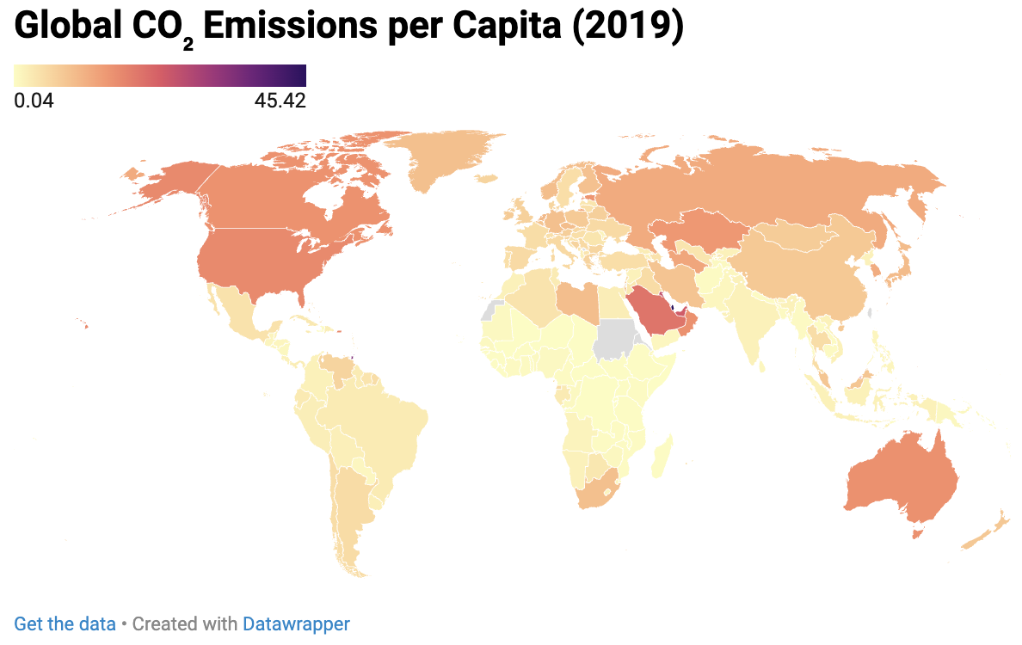
Data Visualization Pitch
Student Individual Assignment
The Cost of Progress
A Trend Analysis of Wealth, Health, and Environment
(1960–2020)
Student name: Hanieh Mirzad
Student ID: 923891
Student e-mail address: h.mirzad@campus.unimib.it
https://github.com/Haniehmzd/Data-Visualization.git

Slide 2
Research questions
Primary Research Question
-How is economic growth related to quality of life and environmental impact across countries?
Secondary Research Questions
- Is higher GDP per capita associated with higher life expectancy?
- Does economic development lead to higher CO₂ emissions?
- How do these relationships differ across world regions?

Slide 3
About Data
Data Source
World Development Indicators (World Bank), publicly available open data.
Selected Indicators
GDP per capita
Life expectancy at birth
CO₂ emissions per capita
Population growth
Data Considerations
The dataset is publicly available and shared under an open data license
Some missing values were present, especially for earlier years
Data is generally reliable but may reflect estimation methods used by the World Bank
Data Cleaning
Missing values handling
Merging multiple indicators into a single dataset
Filtering years and countries

Slide 4
Methodology
Data Collection:
Data downloaded from the World Bank official website (CSV format)
Data Processing & Cleaning:
Python (pandas, numpy)/ Data merging and filtering / Handling missing values
Data Transformation:
Multiple datasets were merged by country and year.
GDP per capita values were log-transformed for visualization to reduce skewness and improve interpretability.
Countries were mapped to world regions (Africa, Americas, Asia, Europe, Oceania) for regional comparison.
Visualization Tools & Techniques:
Python libraries Seaborn (built on Matplotlib) were used to create a scatter plot exploring the relationship between GDP per capita and life expectancy.
Datawrapper was used to produce a choropleth map illustrating CO₂ emissions per capita across countries.
Use of AI Tools:
ChatGPT was used to support textual explanation and report structuring.
Analytical Techniques:
Descriptive statistics to examine distributions and ranges of key indicators.
Trend analysis to study long-term changes in CO₂ emissions over time.
Correlation analysis to explore relationships between economic, health, and environmental variables.
Reproducibility:
Analysis can be replicated using the provided datasets and Python notebooks

Slide 5
Insights from the Data
Insights from the Data
Higher GDP per capita is associated with higher life expectancy across countries.
The GDP–life expectancy relationship shows diminishing returns at high income levels.
CO₂ emissions per capita increase with economic development, especially in industrialized regions.
Developing regions show rapid growth in CO₂ emissions over time.
Higher population growth appears to be associated with lower life expectancy in several regions. Strong regional differences exist in economic, health, and environmental indicators.
Analysis Methods Used
Descriptive statistics
Correlation analysis
Trend and comparative analysis

Slide 6
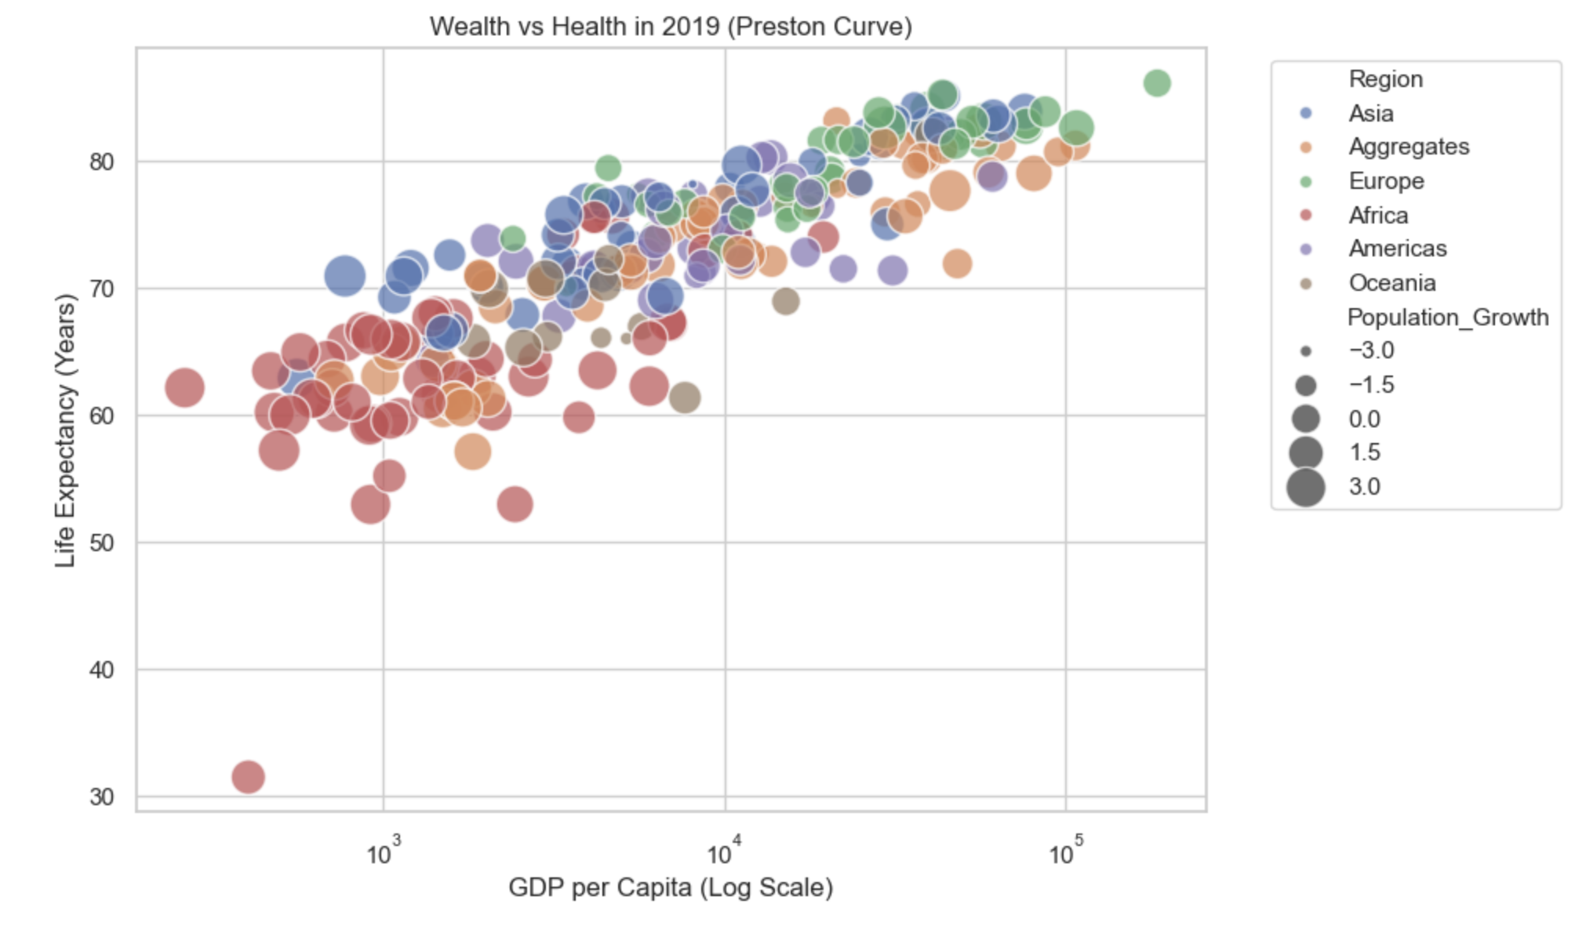
Economic Growth and Health Outcomes
This visualization shows the relationship between GDP per capita and life expectancy in 2019.
A clear positive relationship emerges, although diminishing returns are observed at higher income levels.

Slide 7
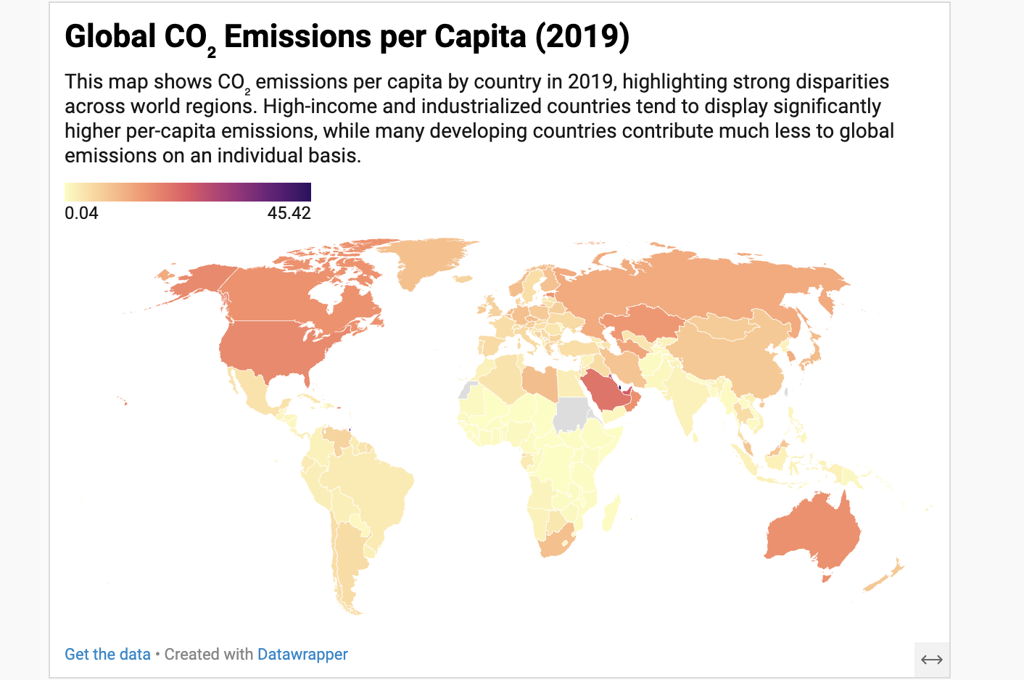
These differences highlight the challenge of achieving economic growth while limiting environmental impact.

Slide 8
While economic growth is associated with improved quality of life, it also generates significant environmental pressure.
These findings highlight the challenge of achieving sustainable development that balances prosperity, health, and environmental responsibility.

Slide 9
LICENCE
Slides are shared with the following license:
The Cost of Progress by Hanieh Mirzad
is licensed under Creative Commons Attribution 4.0 International (CC BY 4.0)
https://github.com/Haniehmzd/Data-Visualization.git

